Slide 1
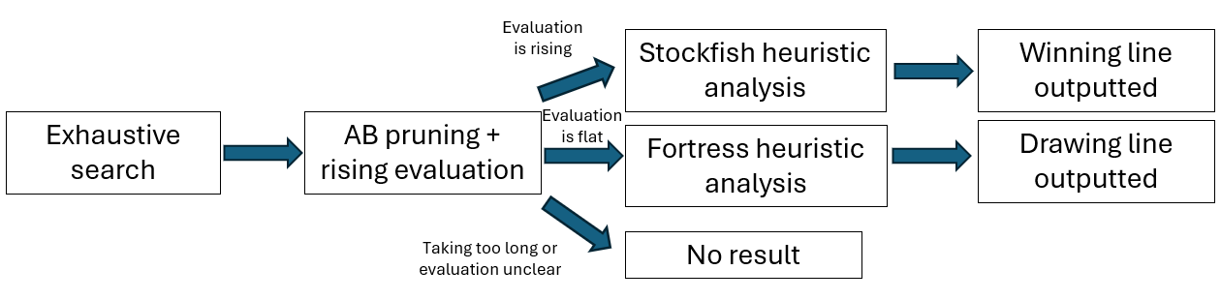
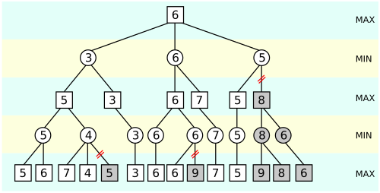
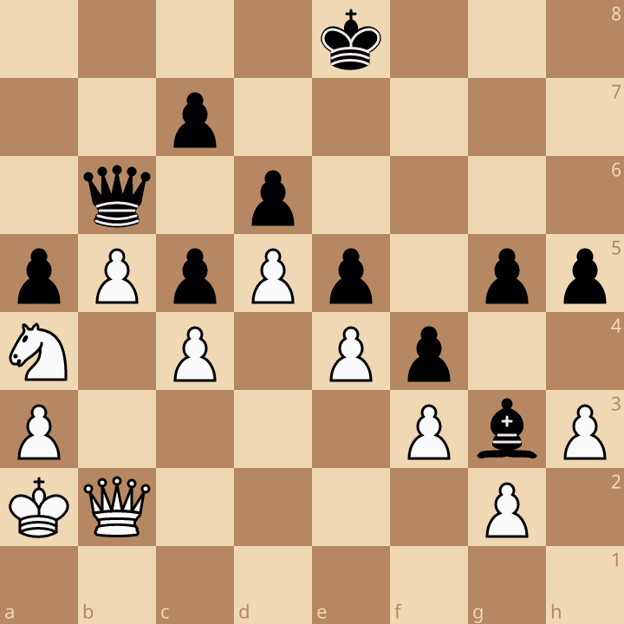
Chess Fortresses: Analysis of Drawn
Positions Under Material Imbalance
Daniel Rhodes
Alessandro Astolfi
Department of Electrical and Electronic Engineering
          Introduction
          A chess "fortress" is a drawn position where one side holds an impenetrable defensive setup despite being materially behind
          Chess engines are tuned for tactical, materialistic play, but fortresses require long-term strategic judgement instead
          This makes fortress positions a rich, underexplored area for algorithmic study
          How does my engine work?
          Engine was composed of 3 parts:
          Exhaustive search
          Alpha-Beta pruning with rising evaluation
          Heuristic analysis
          Stage 1: Exhaustive search
          Exhaustively searches through every possible move for 4-6 moves
          Ensures that no possible breakthrough move is missed, and that engine does not prune away less promising moves too early
          Stage 2: Alpha-Beta pruning with rising evaluation
          Starts from every possible position found through the exhaustive search
          Runs a pruning search to find the most promising lines, and checks evaluation as the search goes deeper
          If evaluation stays flat – fortress is assumed
          If evaluation keeps rising – breakthrough assumed
          Examines these lines with the next stage to find winning lines
          Stage 3: Heuristic analysis
          Analyses the resulting lines with heuristics
          If breakthrough move found: looks at things like material advantage, piece activity and tactics, tries to find a winning line, heuristics adapted from Stockfish
          If no breakthrough move found: falls back to fortress heuristics coded myself, holds the draw
          Flow chart of how the engine works.
          How do current engines compare?
          Current engine weaknesses:
          Prune away lines that might be winning, especially involving a sacrifice
          Are too materialistic:
          Will take free material even if this leads to a fortress
          Assigns an advantage to the side with more material even if the position is a dead draw
          How my engine addresses this:
          Exhaustively checks every move to ensure possible sacrifices aren’t pruned away
          Rising evaluation phase prevents taking free material if there is a better line
          Reports either a win, draw, loss, or unclear if the position cannot be solved – to avoid hallucinating an advantage
          Motivation
          Building an all-purpose chess engine in this timeframe, with one developer, would be impossible
          No current engine is designed exclusively for fortress positions
          Existing engines often misjudge fortresses, overvaluing material at the expense of positional understanding
          This leaves a niche that this project aims to fill
          Testing, Results and Evaluation
          Testing:
          Tested against tablebases, current engines and known fortress positions
          Results:
          Performed well in simpler positions
          Struggled in more complex positions – either too slow or could not find the right line
          Evaluation:
          Engine underperformed expectations, but remains a solid proof of concept
          A diagram of the alpha-beta pruning algorithm
          How do existing engines work?
          Combination of heuristics and optimisation algorithms, especially alpha-beta pruning, then assigns an evaluation to the position
          Heuristics include (but not limited to):
          Material advantage
          Piece activity
          King safety
          Tactics
          Positional advantage
          Alpha-Beta Pruning:
          Minimax algorithm that prunes away moves and lines that are worse than other lines from a given position
          “Worse” as defined by the heuristics which can fail
          Conclusions
A solid first prototype, though performance fell short of initial goals
Future work could include:
  Optimising the code for faster execution
Incorporating neural networks (e.g. AlphaZero, Leela) for stronger play
          Acknowledgements
Lichess for providing a games database and engine tools
Syzygy for their endgame tablebases
Wikimedia commons for the alpha-beta pruning image
          Dvoretsky’s fortress study – most engines will take the free queen, but this leads to an indestructible fortress. Qd2 is the best move.

